Slide 1
Setter Injection with Dependent Object
We can inject the dependency by constructor.
The <constructor-arg> sub-element of <bean> is used for constructor injection.
We can inject
primitive and String-based values
Dependent object (contained object)
Collection values etc.

Slide 2
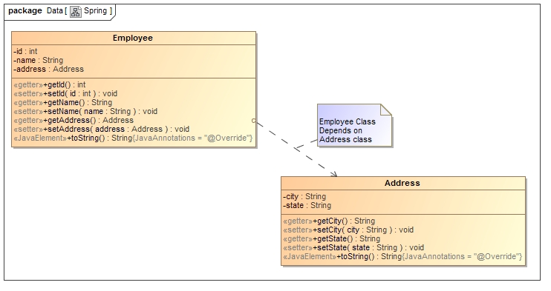
Setter Injection with Dependent Object
Employee HAS-A Address. The Address class object will be termed as the dependent object.

Slide 3
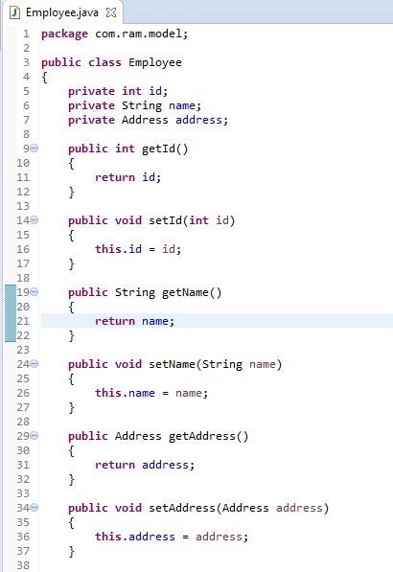
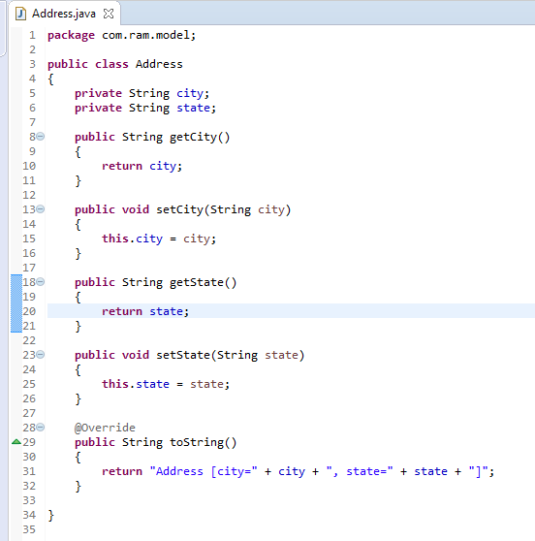
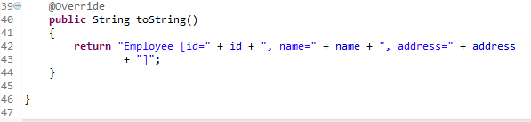
Setter Injection with Dependent Object

Slide 4
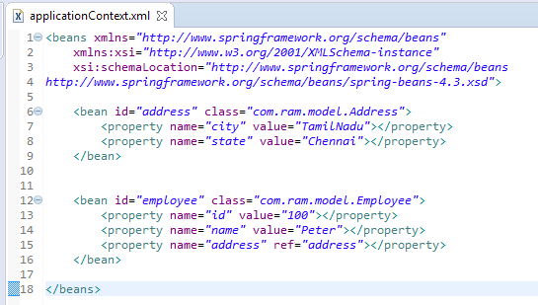
We are providing the information into the bean by applicationContext.xml file.
The property element invokes the setter method.
The ref attribute of property elements is used to define the reference of another bean.

Slide 5
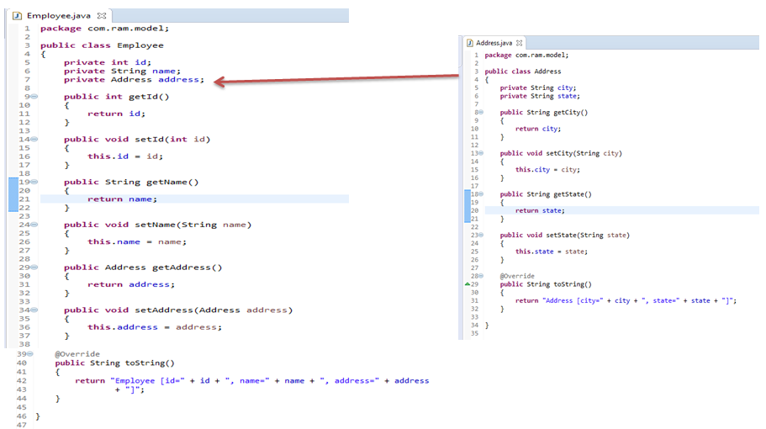
Setter Injection with Dependent Object
Employee,
Address
What objects to instantiate?
What objects to configure and how to configure?
What objects to be assembled?
The Spring Container
(ApplicationContext)
applicationContext.xml
Employee
Object
id=100,
name=Peter, a
ddress=Address [
city=TamilNadu, state=Chennai]
Create the address and employee objects.
Configure the address and employee objects.
Wire the address and employee objects together.
Manage address and employee objects complete life cycle from creation till destruction.

Slide 6
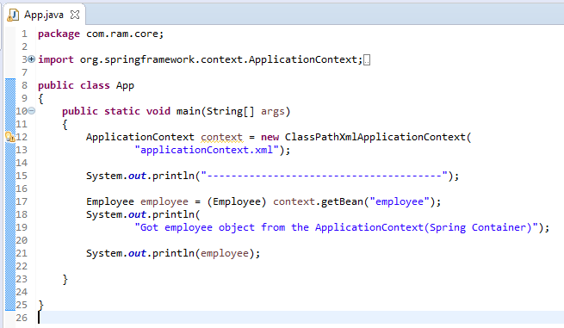
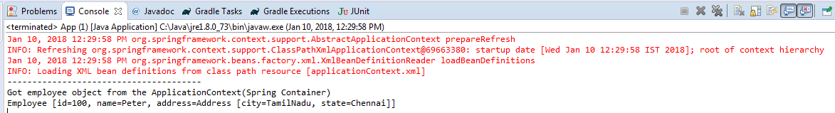
Setter Injection with Dependent Object

